Slide 1
E-COMMERCE DELIVERY ANALYTICS: SWIGGY & BLINKIT
PRESENTED BY
UPPALA SRUJANA

Slide 2
PROBLEM STATEMENT
E-commerce delivery platforms generate large amounts of order data that is difficult to analyze manually.
Business need insights about orders, revenue, delivery time, and customer satisfaction.
It is challenging to identify delivery delays and refund patterns without proper visualization.
Comparing performance between Swiggy and Blinkit requires structured analysis.
Therefore, a dashboard was created using Microsoft Power BI to convert raw data into meaningful insights.

Slide 3
OBJECTIVE
Analyze total orders and revenue generated.
Monitor delivery time performance.
Understand customer ratings and feedback.
Identify popular product categories and order trends.
Compare performance of Swiggy and Blinkit using Microsoft Power BI.

Slide 4
OVERVIEW
This project analyzes delivery and order performance of food delivery platforms. The dashboard was created using Microsoft Power BI Desktop to identify trends in orders, revenue, delivery efficiency, and customer satisfaction.
Tools Used:
Microsoft Excel
Microsoft Power BI
Data Visualization Techniques

Slide 5
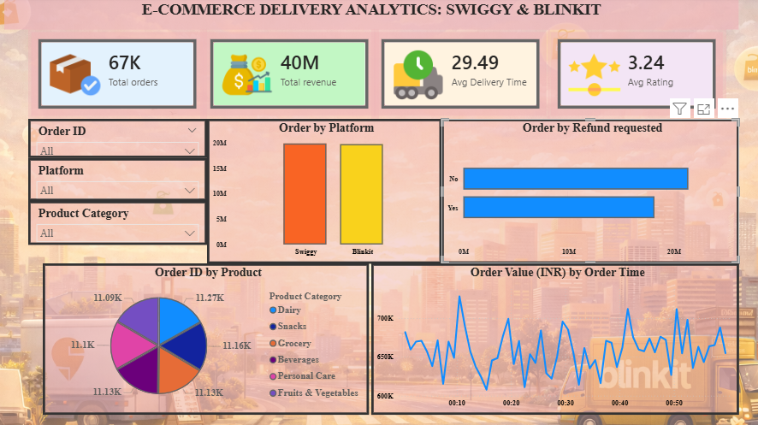
DASHBOARD OVERVIEW
This dashboard provides a comprehensive analysis of ecommerce delivery performance for Swiggy and Blinkit.
It highlights key metrics such as total orders, total revenue, average delivery time, and customer ratings.
The dashboard also analyzes order distribution by platform, product category, refund requests, and order trends over time.

Slide 6
KEY METRICS
Total Orders: 67K
Total Revenue: 40M
Average Delivery Time: 29.49 Minutes
Average Customer Rating: 3.24

Slide 7
VISUALIZATIONS USED
Card Visuals – To display key metrics like total orders, revenue, delivery time, and ratings.
Stacked column Chart – To compare orders between Swiggy and Blinkit.
Stacked Bar Chart – To analyze refund requests.
Pie Chart – To show order distribution by product category.
Line Chart – To analyze order trends over time.
Slicers (Filters) – To filter data by Order ID, Platform, and Product Category.

Slide 8
KEY INSIGHTS
Total revenue reached 40M indicating strong business performance.
Average delivery time is around 29 minutes.
Customer rating is 3.24, showing moderate satisfaction.
Some product categories contribute more to total orders.
Refund requests are relatively lower compared to successful orders.

Slide 9
CONCLUSION
The dashboard provides insights into order trends, delivery efficiency, and customer satisfaction.
It helps businesses improve operations and enhance customer experience.

Slide 10


